Slide 1

Gifted, Sent, and Strengthened
Matthew 10:5–7 & Luke 10:1
Notes:
Stuart Fain ~ June 14, 2026

Slide 2
Matthew 10:5–7 (NASB)
⁵ These twelve Jesus sent out after instructing them, saying, "Do not go on a road to Gentiles, and do not enter a city of Samaritans;

Slide 3
Matthew 10:5–7 (NASB)
⁶ but rather go to the lost sheep of the house of Israel. ⁷ "And as you go, preach, saying, 'The kingdom of heaven has come near.'

Slide 4
Luke 10:1 (NASB)
Now after this the Lord appointed seventy-two others, and sent them in pairs ahead of Him to every city and place where He Himself was going to come.

Slide 5
When God Sends…
He EQUIPS His People
He ORGANIZES His People
He WARNS His People
He STAYS With His People

Slide 6
When God Sends,
He EQUIPS His People

Slide 7
Matthew 10:1 (NASB)
Jesus summoned His twelve disciples and gave them authority over unclean spirits, to cast them out, and to heal every disease and every sickness.

Slide 8
Luke 10:9 (NASB)
and heal those in it who are sick, and say to them, 'The kingdom of God has come near to you.'

Slide 9
Zechariah 4:6 (NKJV)
So he answered and said to me: "This is the word of the LORD to Zerubbabel: "Not by might nor by power, but by My Spirit,' Says the LORD of hosts.

Slide 10
When God Sends, He ORGANIZES His People

Slide 11
Matthew 10:9-14 (NASB)
⁹ "Do not acquire gold, or silver, or copper for your money belts, ¹⁰ or a bag for your journey, or even two tunics, or sandals, or a staff; for the worker is deserving of his support.

Slide 12
Matthew 10:9-14 (NASB)
¹¹ "And whatever city or village you enter, inquire who is worthy in it, and stay at his house until you leave that city. ¹² "As you enter the house, give it your greeting. ¹³ "If the house is worthy, see that your blessing of peace comes upon it.

Slide 13
Matthew 10:9-14 (NASB)
But if it is not worthy, take back your blessing of peace. ¹⁴ "And whoever does not receive you nor listen to your words, as you leave that house or city, shake the dust off your feet.

Slide 14
Luke 10:4-8 (NASB)
⁴ "Carry no money belt, no bag, no sandals, and greet no one along the way. ⁵ "And whatever house you enter, first say, 'Peace be to this house.' ⁶ "And if a man of peace is there, your peace will rest upon him; but if not, it will return to you.

Slide 15
Luke 10:4-8 (NASB)
⁷ "Stay in that house, eating and drinking what they provide; for the laborer is deserving of his wages. Do not move from house to house. ⁸ "Whatever city you enter and they receive you, eat what is served to you;

Slide 16
Proverbs 24:3–4 (NKJV)
³ Through wisdom a house is built, And by understanding it is established; ⁴ By knowledge the rooms are filled With all precious and pleasant riches.

Slide 17
When God Sends, He WARNS His People

Slide 18
Matthew 10:16–25 (NASB)
¹⁶ "Behold, I am sending you out as sheep in the midst of wolves; so be as wary as serpents, and as innocent as doves. ¹⁷ "But be on guard against people, for they will hand you over to the courts and flog you in their synagogues;

Slide 19
Matthew 10:16–25 (NASB)
¹⁸ and you will even be brought before governors and kings on My account, as a testimony to them and to the Gentiles. ¹⁹ "But when they hand you over, do not worry about how or what you are to say; for what you are to say will be given you in that hour.

Slide 20
Matthew 10:16–25 (NASB)
²⁰ "For it is not you who are speaking, but it is the Spirit of your Father who is speaking in you. ²¹ "Now brother will betray brother to death, and a father his child; and children will rise up against parents and cause them to be put to death.

Slide 21
Matthew 10:16–25 (NASB)
²² "And you will be hated by all because of My name, but it is the one who has endured to the end who will be saved.
²³ "But whenever they persecute you in one city, flee to the next;

Slide 22
Matthew 10:16–25 (NASB)
for truly I say to you, you will not finish going through the cities of Israel until the Son of Man comes. ²⁴ "A disciple is not above his teacher, nor a slave above his master.

Slide 23
Matthew 10:16–25 (NASB)
²⁵ "It is enough for the disciple that he may become like his teacher, and the slave like his master. If they have called the head of the house Beelzebul, how much more will they insult the members of his household!

Slide 24
Psalms 34:19 (NKJV)
Many are the afflictions of the righteous, But the LORD delivers him out of them all.

Slide 25
When God Sends, He STAYS With His People

Slide 26
Matthew 10:26–31 (NLT)
²⁶ "But don't be afraid of those who threaten you. For the time is coming when everything that is covered will be revealed, and all that is secret will be made known to all. ²⁷ What I tell you now in the darkness, shout abroad when daybreak comes.

Slide 27
Matthew 10:26–31 (NLT)
What I whisper in your ear, shout from the housetops for all to hear!
²⁸ "Don't be afraid of those who want to kill your body; they cannot touch your soul. Fear only God, who can destroy both soul and body in hell.

Slide 28
Matthew 10:26–31 (NLT)
²⁹ What is the price of two sparrows—one copper coin? But not a single sparrow can fall to the ground without your Father knowing it. ³⁰ And the very hairs on your head are all numbered.

Slide 29
Matthew 10:26–31 (NLT)
³¹ So don't be afraid; you are more valuable to God than a whole flock of sparrows.

Slide 30
Matthew 10:32–33 (KJV)
³² Whosoever therefore shall confess me before men, him will I confess also before my Father which is in heaven.
³³ But whosoever shall deny me before men, him will I also deny before my Father which is in heaven.

Slide 31
Isaiah 41:10 (NKJV)
Fear not, for I am with you; Be not dismayed, for I am your God. I will strengthen you, Yes, I will help you, I will uphold you with My righteous right hand.'

Slide 32
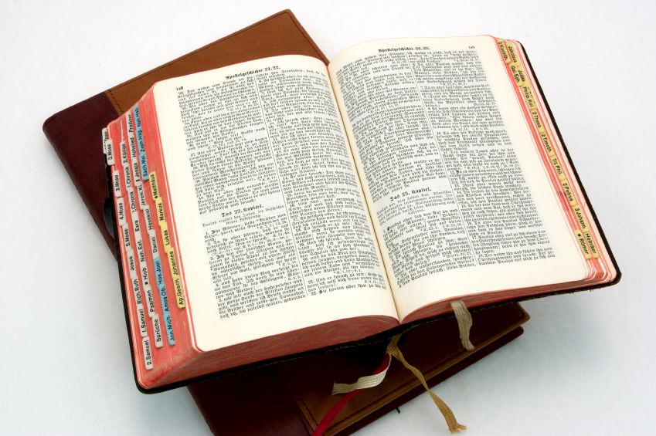
Hear: Romans 10:17
So then faith cometh by hearing, and hearing by the word of God.

Slide 33
Believe: Hebrews 11:6
But without faith it is impossible to please him: for he that cometh to God must believe that he is, and that he is a rewarder of them that diligently seek him.

Slide 34
Repent: Luke 13:3
I tell you, Nay: but, except ye repent, ye shall all likewise perish.

Slide 35
Confess: Matthew 10:32-33
32 Whosoever therefore shall confess me before men, him will I confess also before my Father which is in heaven.
33 But whosoever shall deny me before men, him will I also deny before my Father which is in heaven.

Slide 36
Baptize: Acts 22:16
And now why tarriest thou? arise, and be baptized, and wash away thy sins, calling on the name of the Lord.

